Slide 1
Crime Analysis
Advolution 9.0

Slide 2
Contents
Introduction
Data Transformation and Cleaning
Hotspot of Crimes
General Crime Analysis
Insights
Specific crime analysis
Health System analysis
Steps to be taken

Slide 3
Introduction
Team Name | - varunpatil64228
Members | - Varun S Patil ( Member-1 )
Agendas:-
Overview of Crime Analysis
Identification of Hotspots
Key Insights Unveiled
Next Steps for a Safer Community
Raw Data:- click here for raw data
Transformed Data:- click here for transformed data

Slide 4
Data Transformation and Data Cleaning
The data was pre-pivoted. To categorize the data columns were unpivoted to give clear categories.
The data set had null values with errors such as use of ‘-’ in many columns.
The total category was included which resulted in anomaly in many cases
The grouping of different values especially age groups were performed.
Measures like finding averages and finding common categories were performed.

Slide 5
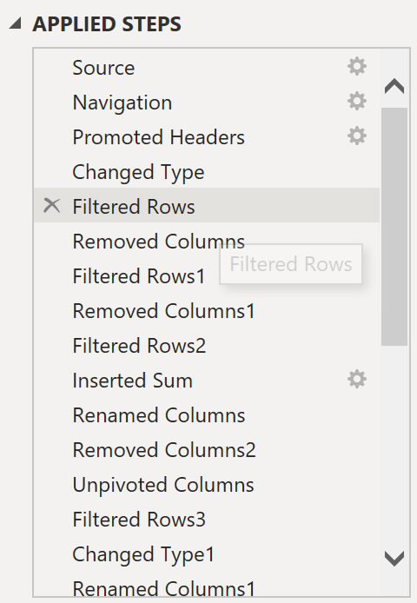
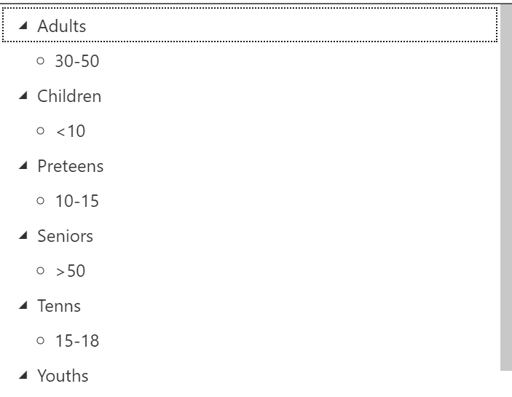
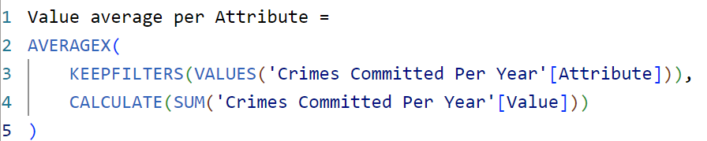
Data Transformation and Data Cleaning snapshots

Slide 6
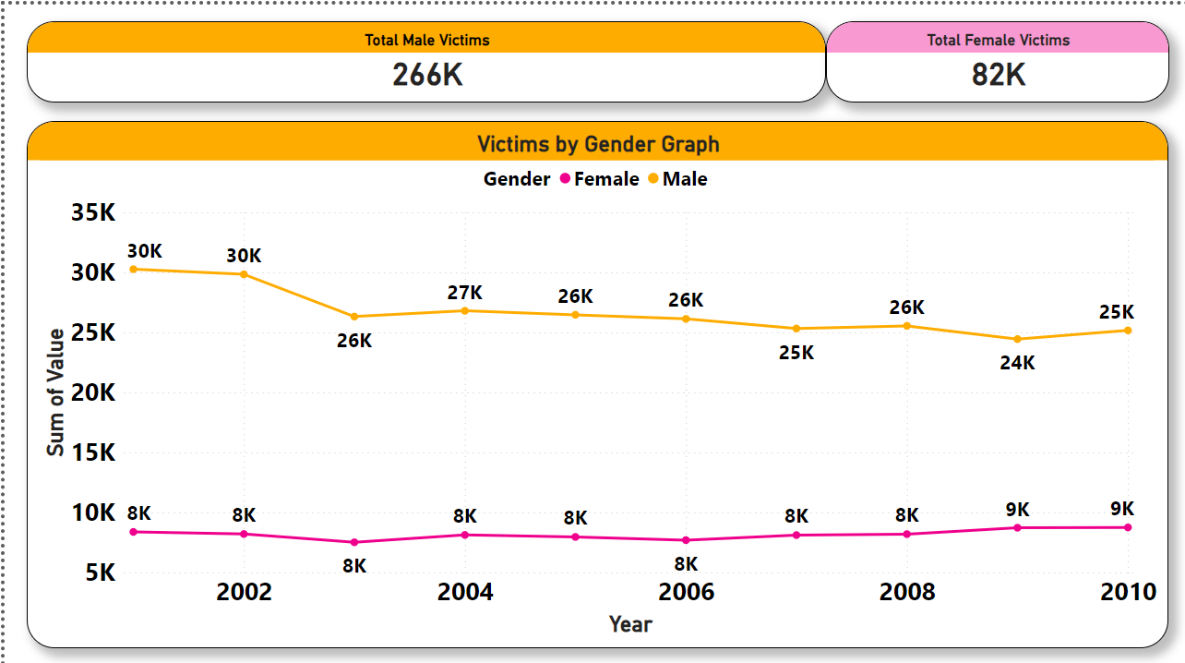
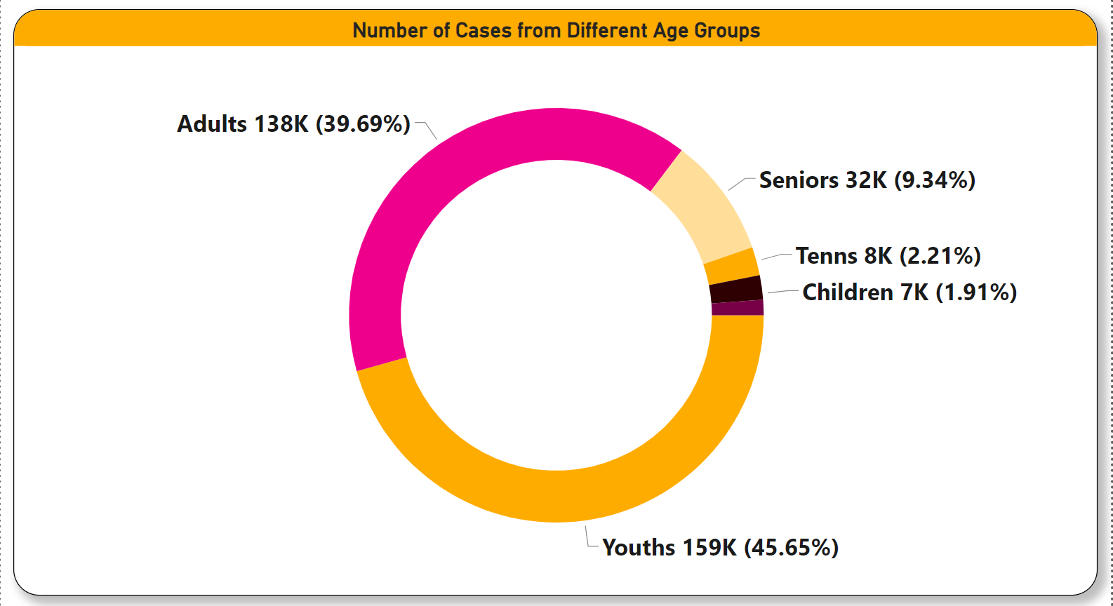
General Crime Analysis
1. The crime rate has remained constant over the past 10 years.
2. Males account for approximately 26k attempted crimes, while females are involved in around 8k attempts.
Youths constitute a significant portion, making up 45.65% of the total.
In comparison, adults account for 39.69% of the overall demographic
The involvement of other age groups is relatively minimal, with the focus primarily on addressing concerns related to youths.

Slide 7
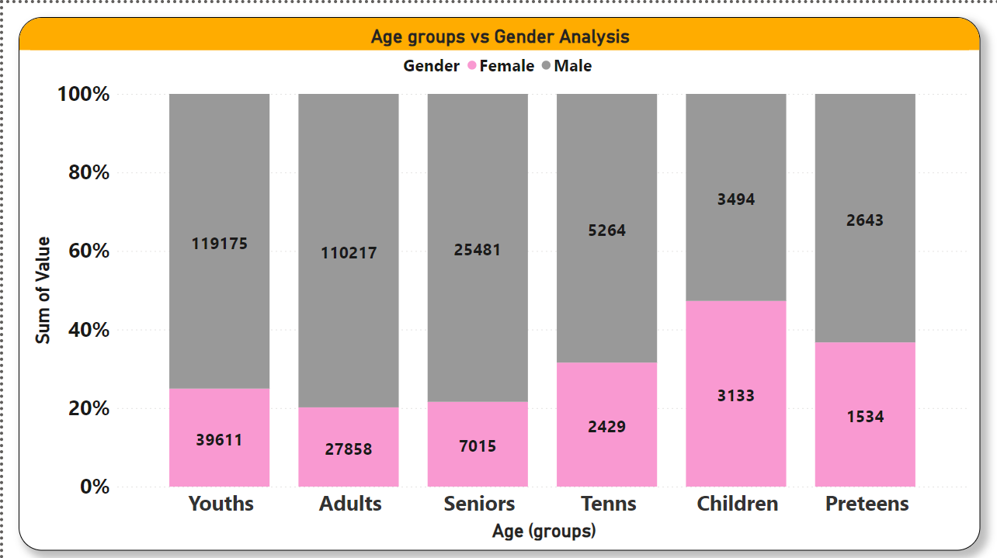
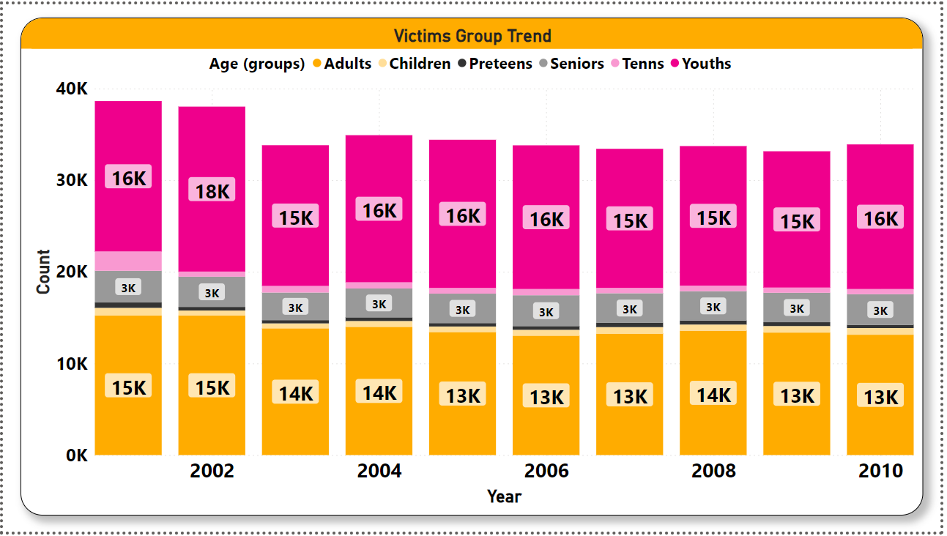
General Crime Analysis
Males dominate all age groups, especially in youths.
However, in the children's group, females have a higher count compared to other groups.
The crime rates for youths, adults, and seniors have remained constant over the past 10 years.

Slide 8
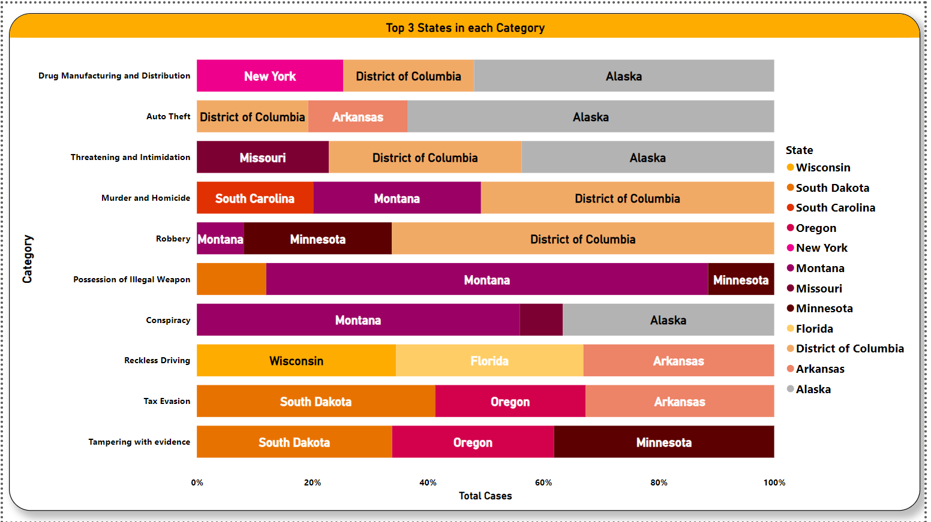
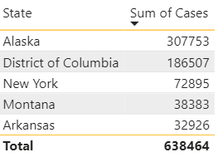
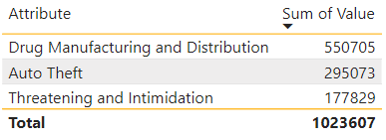
Hotspots for specific crimes within states
The data shows Alaska, Arkansas , District of Columbia, Missouri and New York are major hotspot for crimes making 81.55% of Total cases.
Drug Manufacturing and Distribution ,Auto theft and Threatening- Intimidation are major crimes which make 81.55% of Total Cases.

Slide 9
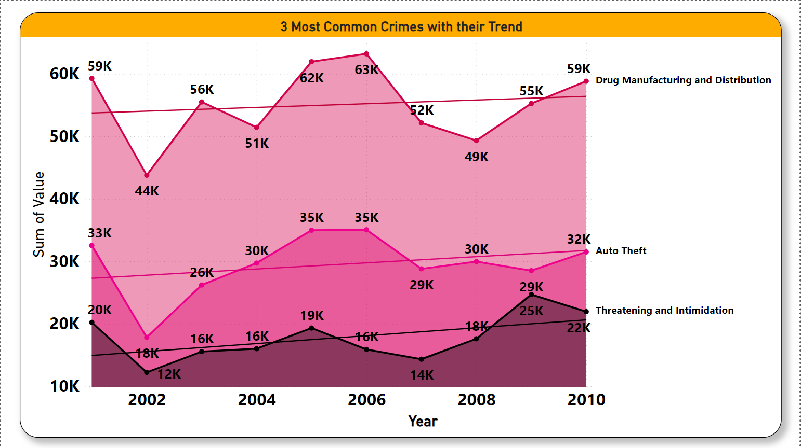
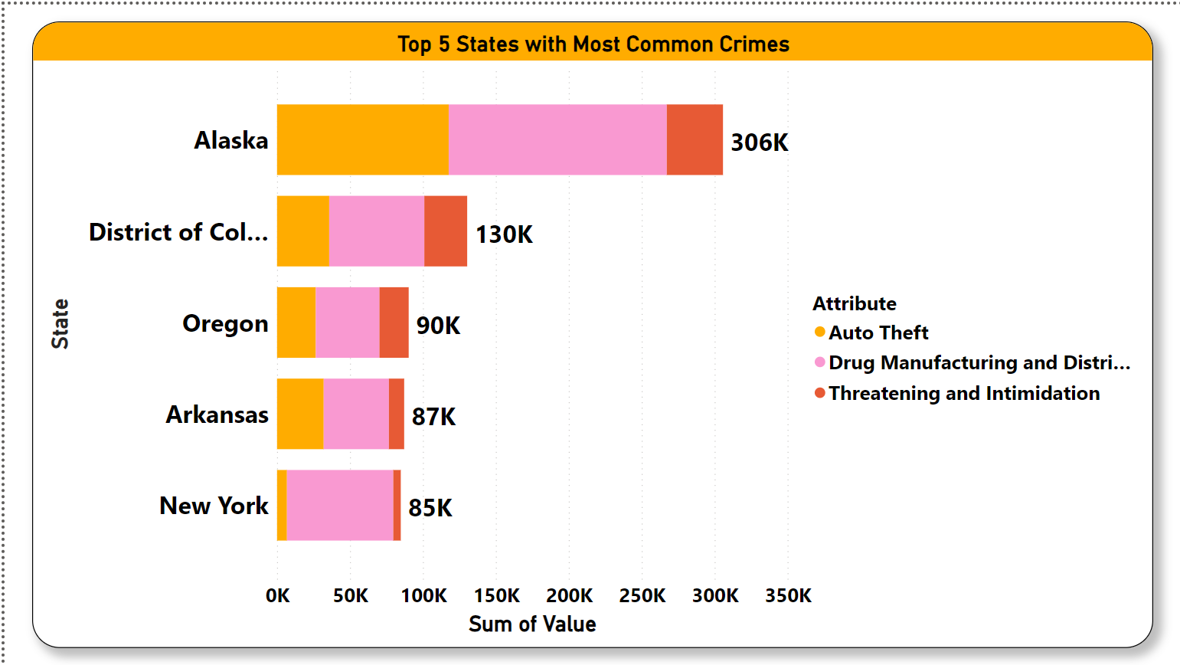
Most Common Crime Activities
The three most common crimes, with an upward trend, are Drug Manufacturing and Distribution, Auto Theft, and Threatening-Intimidation.
Alaska, District of Columbia, Oregon, Arkansas, and New York are identified as hotspots for the most common crimes.

Slide 10
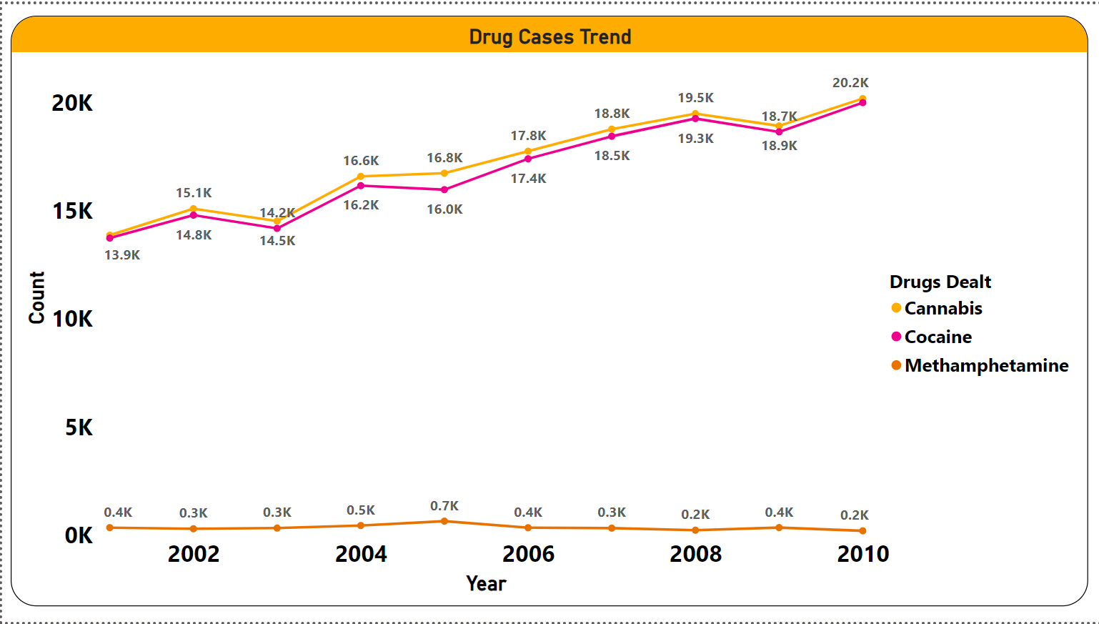
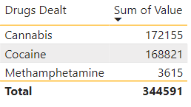
Drug Consumption Analysis
Year by year, drug consumption is on the rise, with Cannabis and Cocaine being the predominant products.
But Methamphetamine has constant rate of about 0.2k

Slide 11
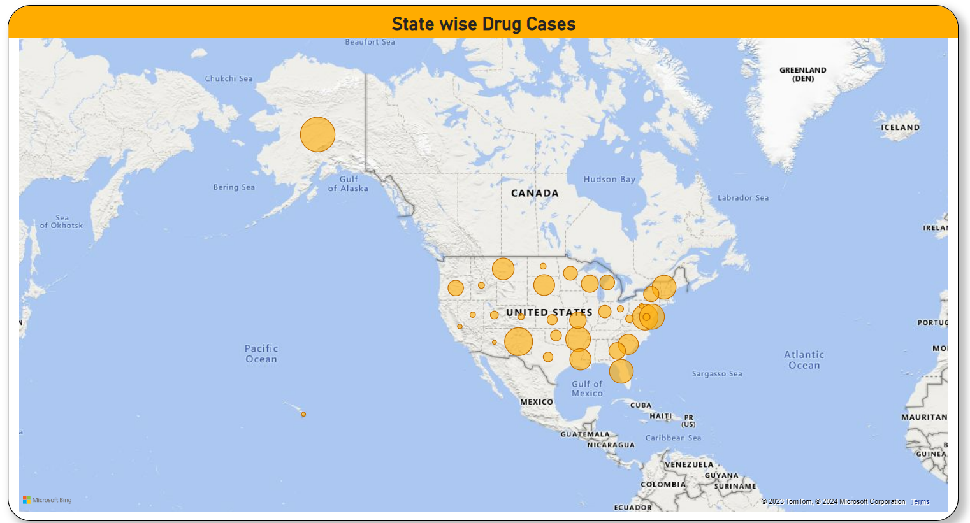
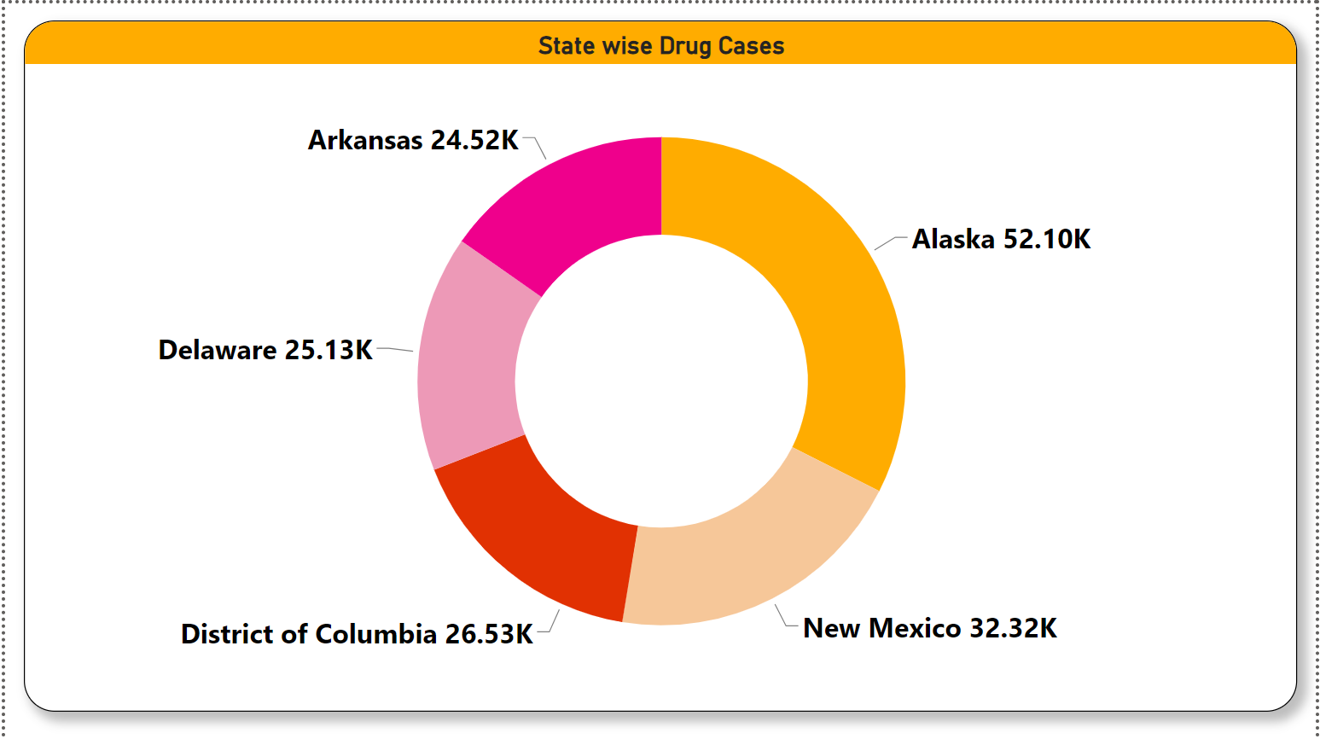
Drug Consumption Analysis
Alaska, New Mexico, District of Columbia, Delaware, and Arkansas emerge as hotspots for drug consumption. Out of the total 345k cases, these hotspots account for 160.59k, constituting 46.54%.

Slide 12
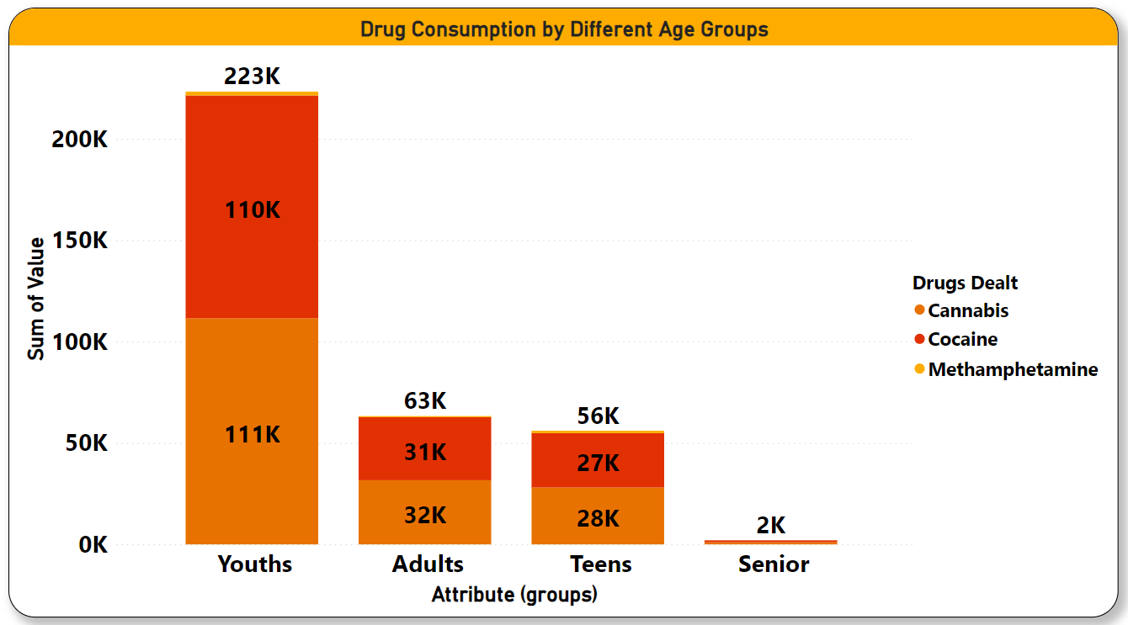
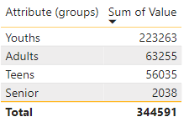
Drug Consumption in different age groups
Youths consume a lot of drug making 64% of total consumption, adults and teen making 34% of total consumption

Slide 13
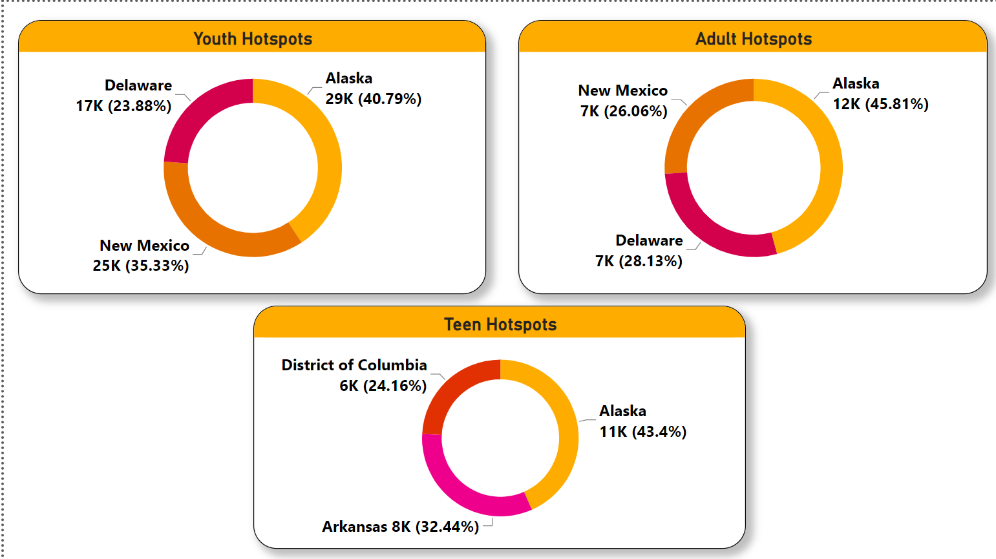
Drug Consumption Hotspots
Hotspots for youth and adults include Alaska, Delaware, and New Mexico. For teens, the hotspots also include Alaska, District of Columbia, and Arkansas.

Slide 14
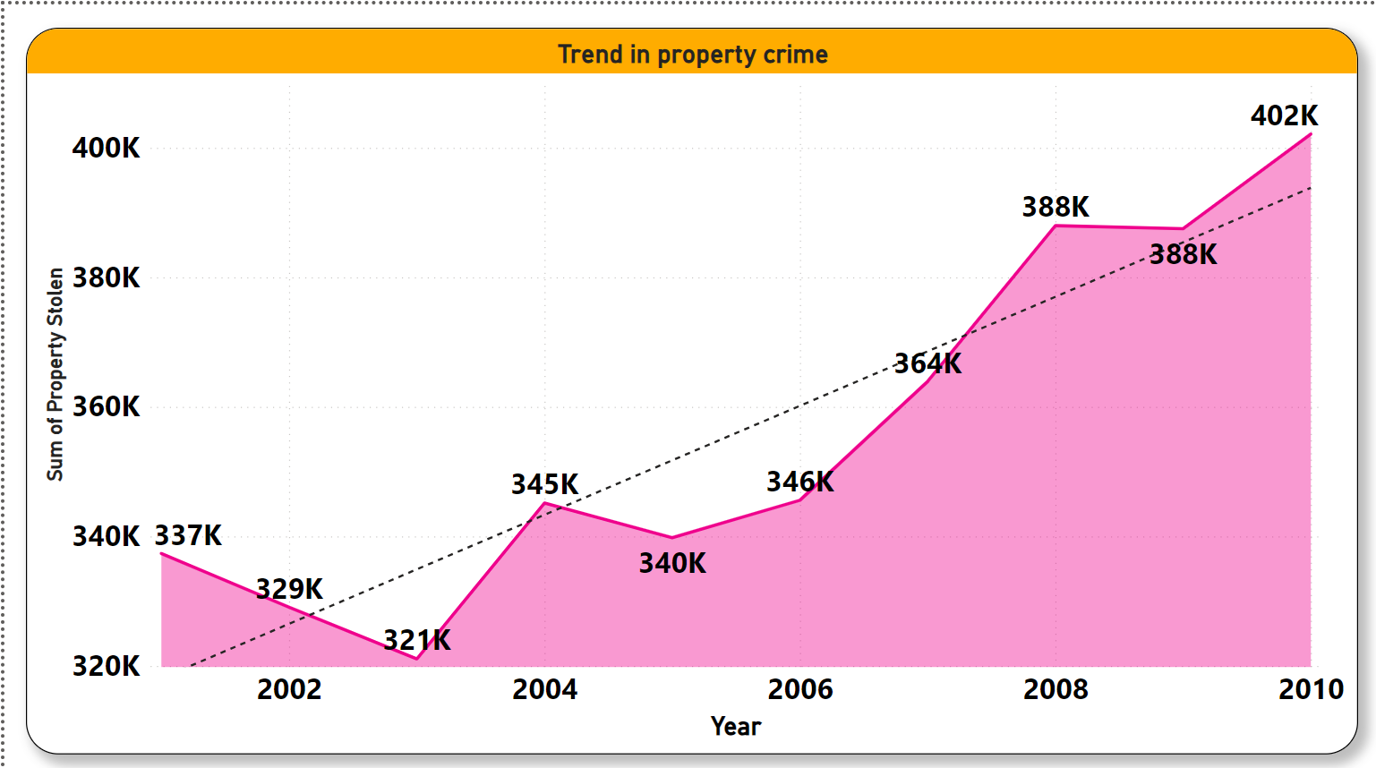
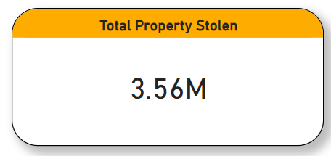
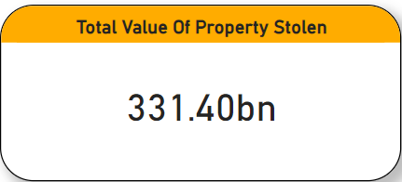
Property Crime Analysis
Property crime is exhibiting a rapid and consistent increase, reaching new highs over the past 10 years.

Slide 15
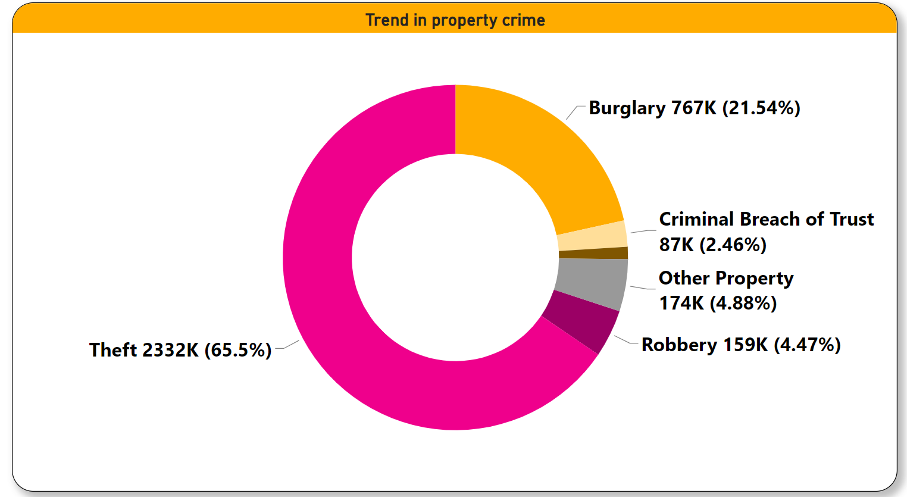
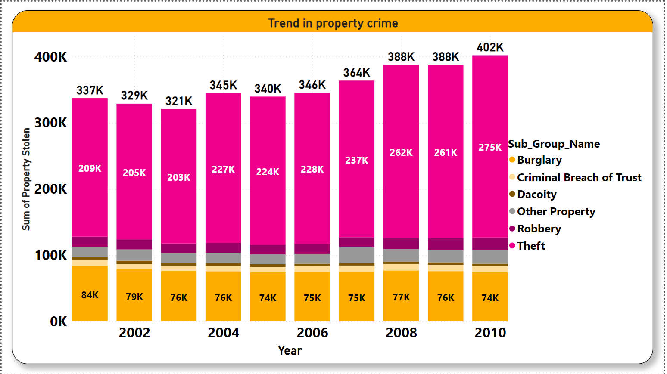
Property Crime Analysis
Theft and burglary constitute a significant portion of property crime (87% combined).
The rate of theft is gradually increasing, while burglary shows fluctuations around an average level.

Slide 16
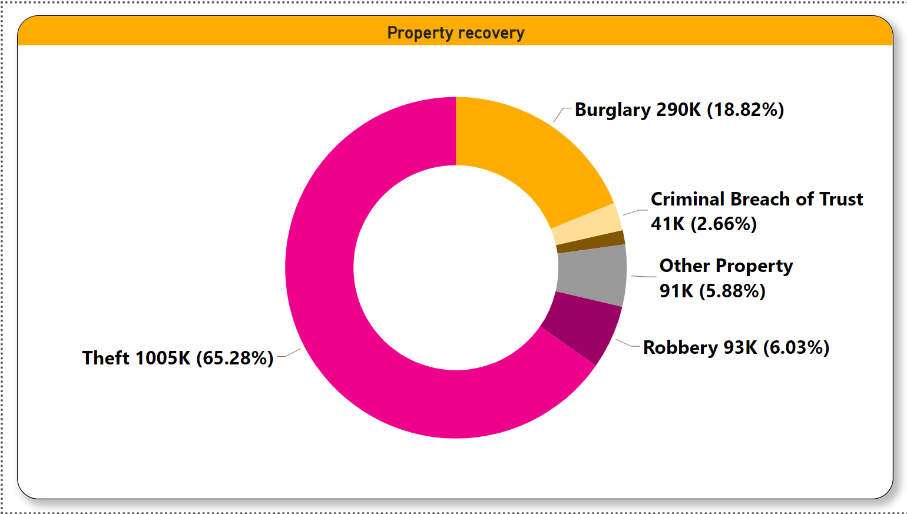
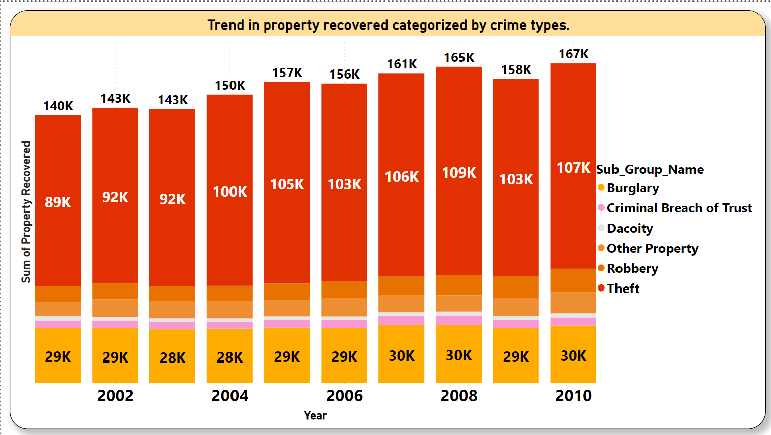
Property Crime Analysis
Theft and burglary constitute a significant portion of property recovery (84.1% combined).
The rate of recovery is gradually increasing, while burglary shows fluctuations around an average level.

Slide 17
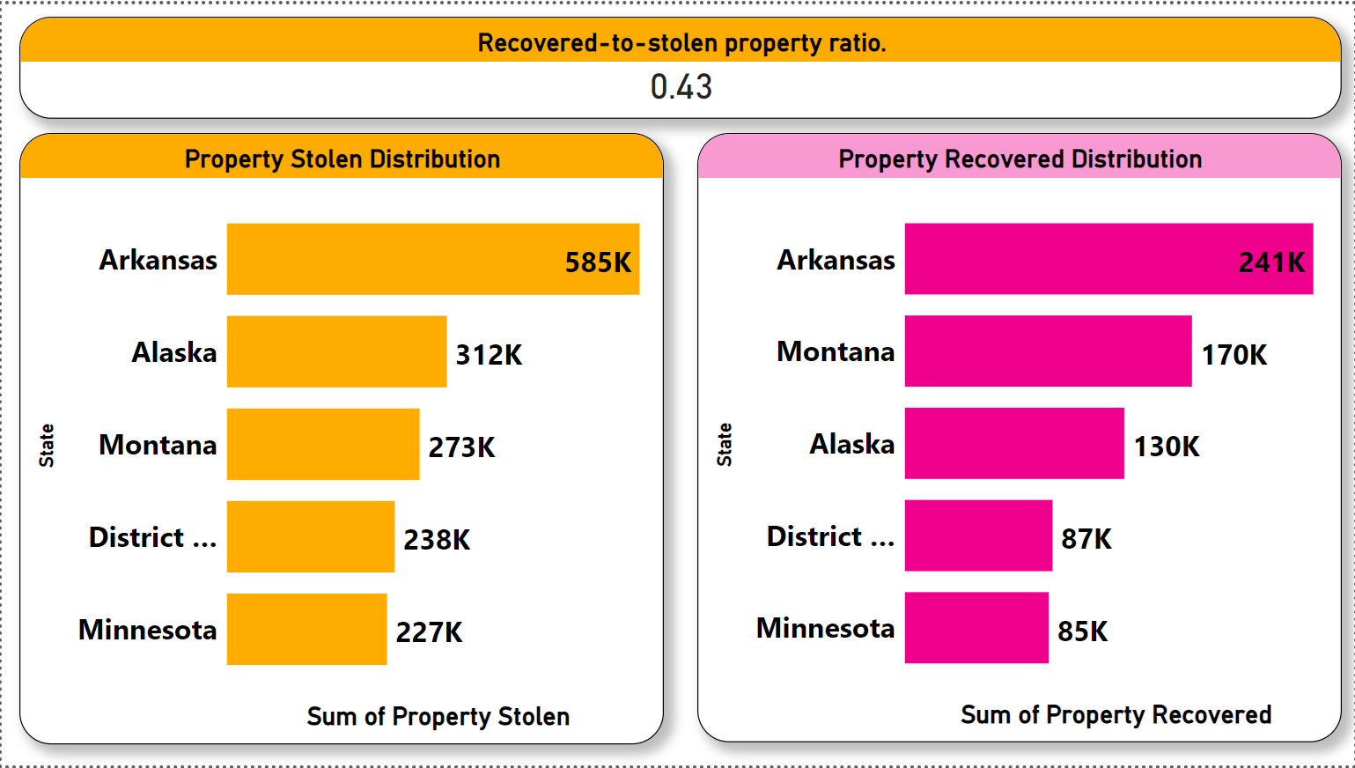
Property Crime Hotspots
The ratio of 0.43 means that, on average, 43% of the total stolen property is recovered. This ratio is calculated by taking the total value of recovered property and dividing it by the total value of stolen property. It provides an indication of the effectiveness of recovery efforts, suggesting that a substantial portion (43%) of stolen property is successfully retrieved.
The hotspots for stealing are Arkansas, Alaska, Montana, District of Columbia, and Minnesota. The recovery follows the same order.

Slide 18
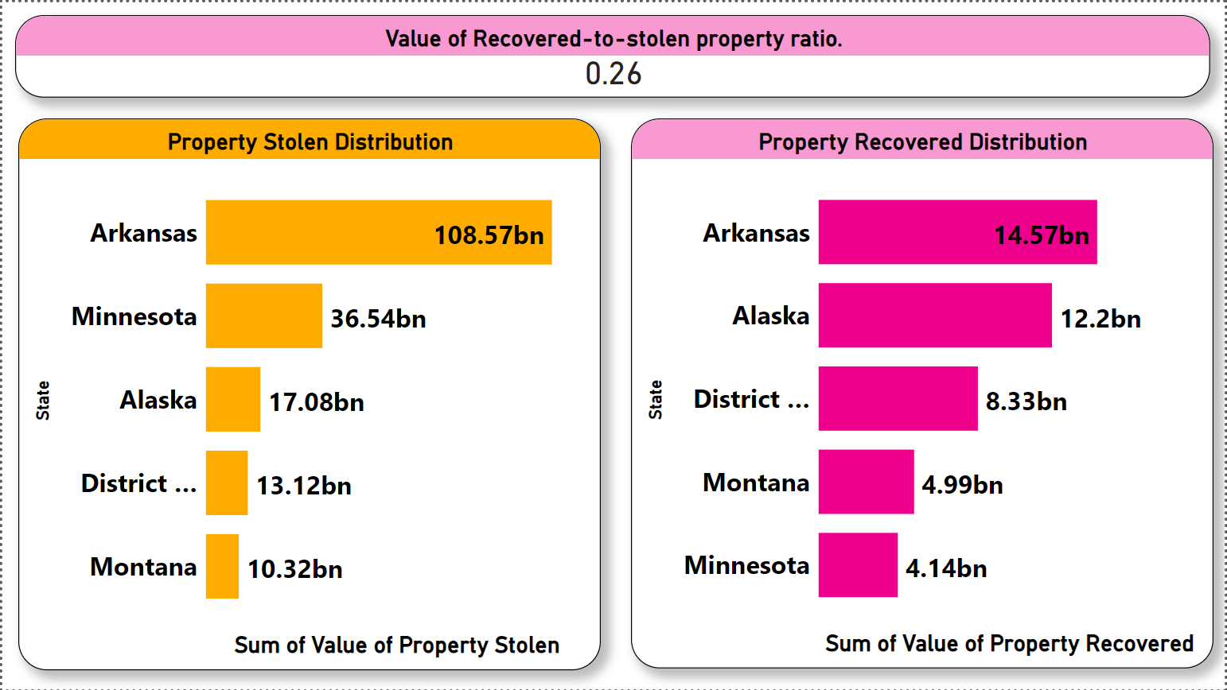
Property Crime Hotspots by Value
The ratio of 0.23 means that, on average, 23% of the total stolen property is recovered by value. This ratio is calculated by taking the total value of recovered property and dividing it by the total value of stolen property. It provides an indication of the effectiveness of recovery efforts, suggesting that a significant portion (23%) of stolen property is successfully retrieved.
The hotspots for stealing are Arkansas, Minnesota, Alaska, Montana, District of Columbia, and Montana. The recovery sequence is Arkansas, Alaska, District of Columbia, Montana, and Minnesota by value.

Slide 19
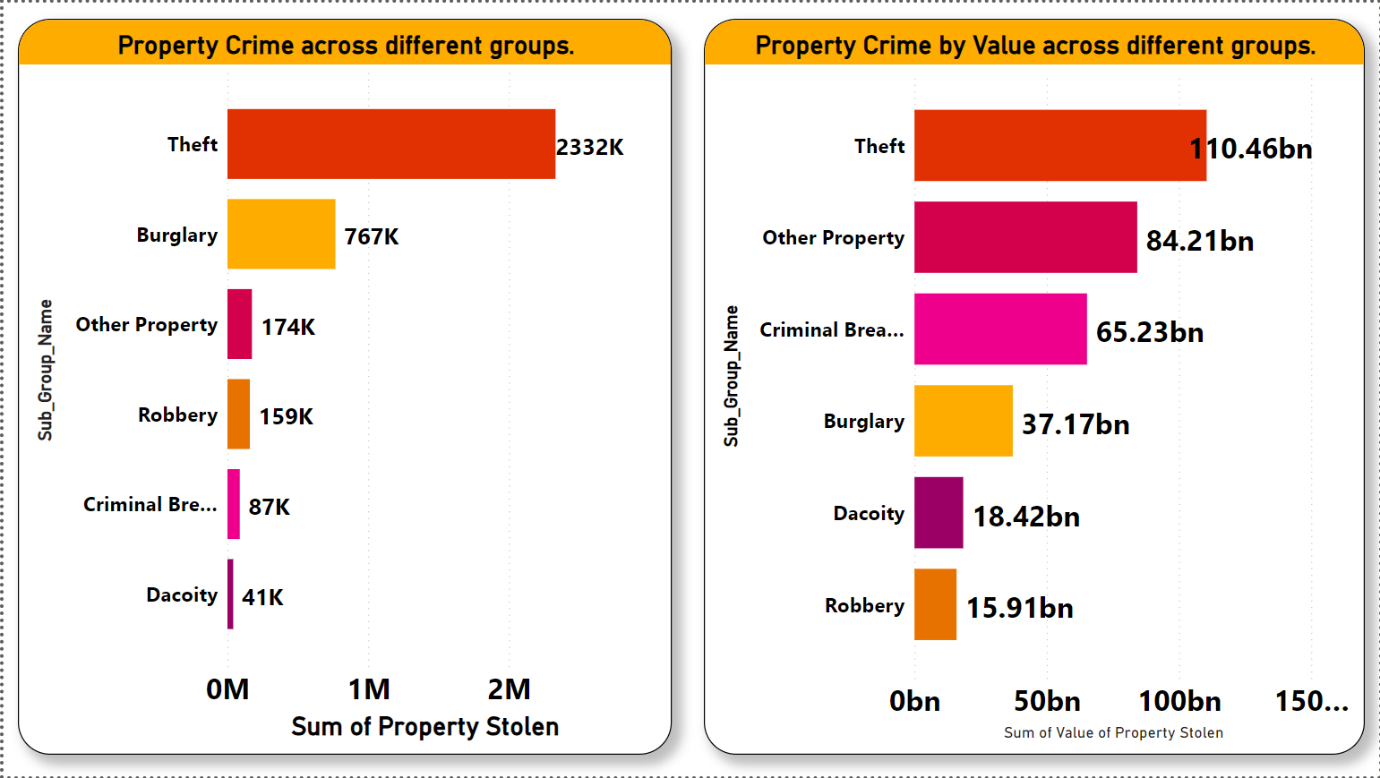
Property Crimes in different groups
Within the property crime categories, theft has the highest incidence, while Dacoity has the least.
By value Theft has maximum total whereas robbery is least.

Slide 20
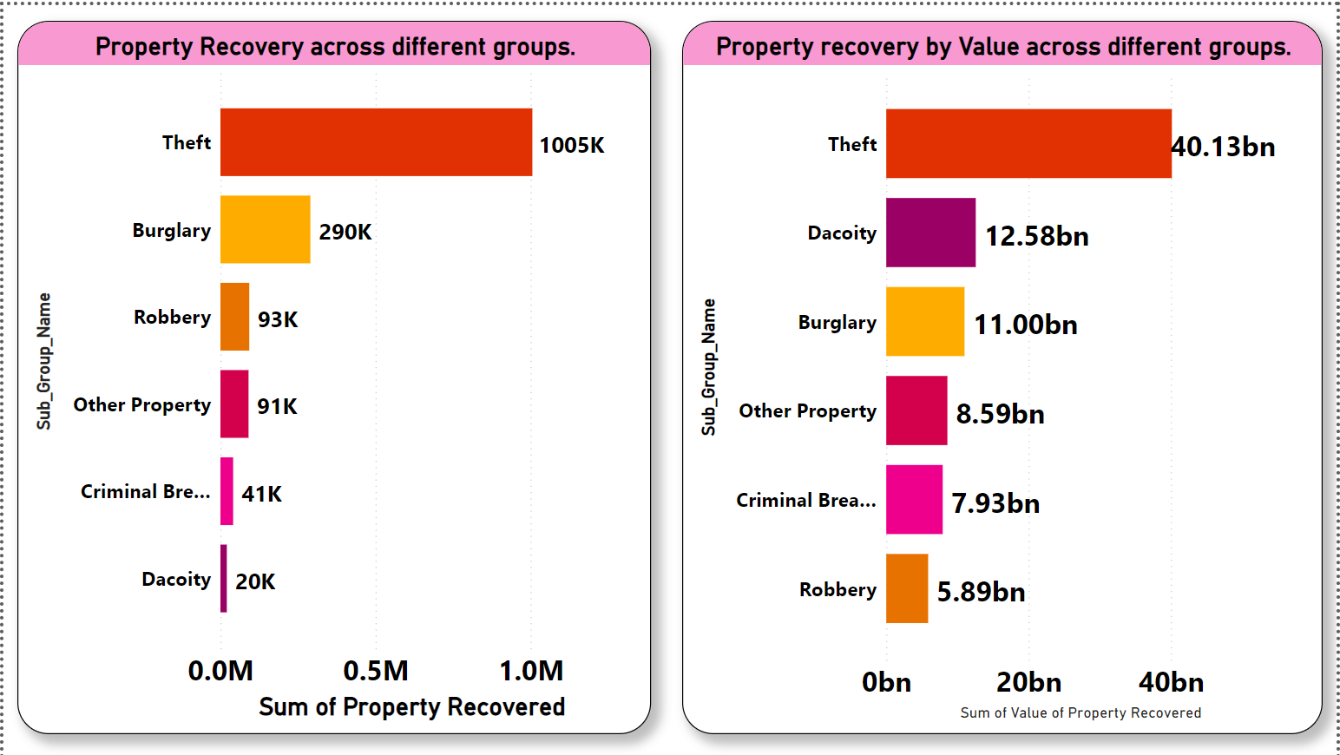
Property Recovery in different groups
Within property crime categories, theft has the highest incidence, while dacoity has the least while recovering. In terms of value, theft has the maximum total, whereas robbery is the least recovered.

Slide 21
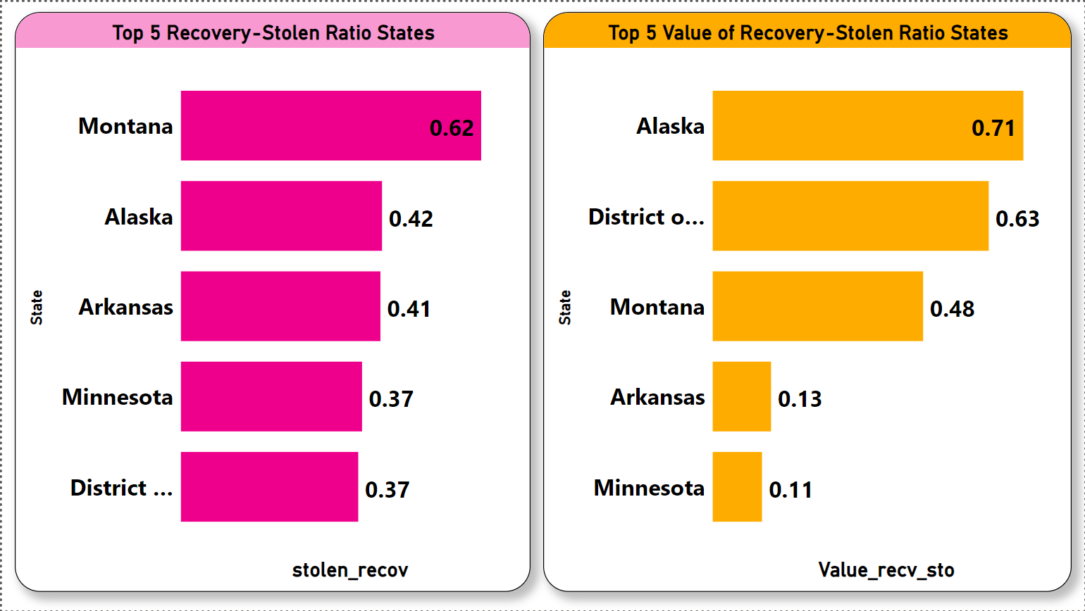
Property Recovery Ratio Analysis
While Recovering Montana has highest ratio whereas District of Columbia has least.
By value Alaska has highest ratio whereas Minnesota has least ratio

Slide 22
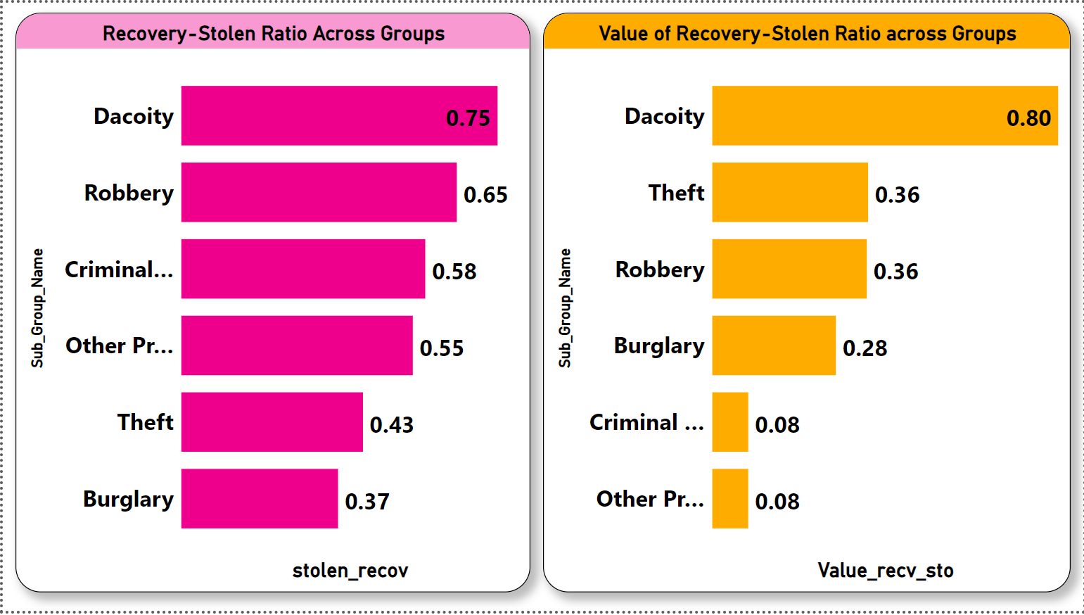
Property Recovery Ratio Analysis Across Groups
While Recovering Dacoity has highest ratio whereas Burglary has least.
By value Dacoity has highest ratio whereas Other property has least ratio

Slide 23
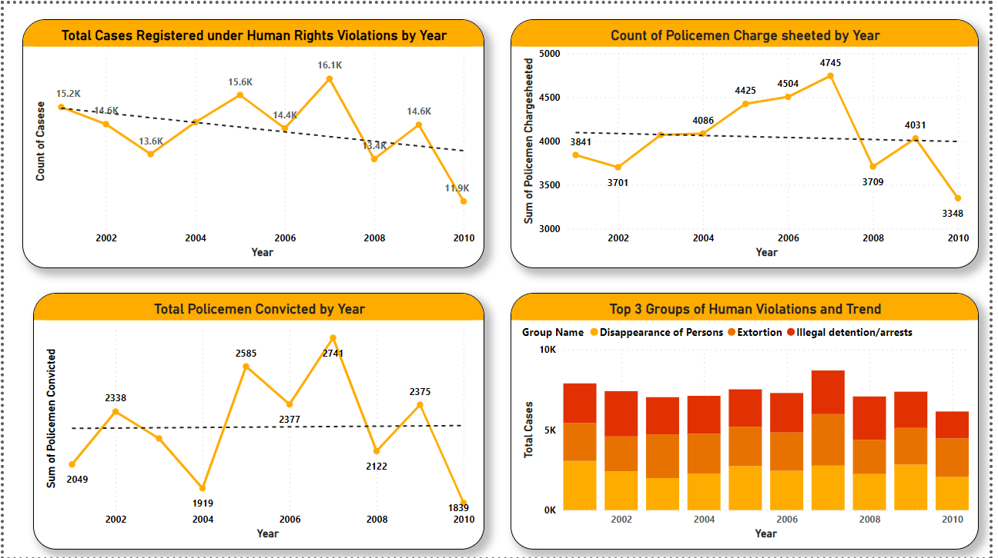
Human rights violation by police
Suddenly, human rights violations by the police have seen a decreasing trend.
The count of charge-sheeted police officers significantly dropped, reaching its lowest in 2010 after a peak in 2007.
Similarly, a downward trend is observed in convictions related to police misconduct.
Key crimes involving police violations include sudden disappearances, extortion, and illegal arrests.

Slide 24
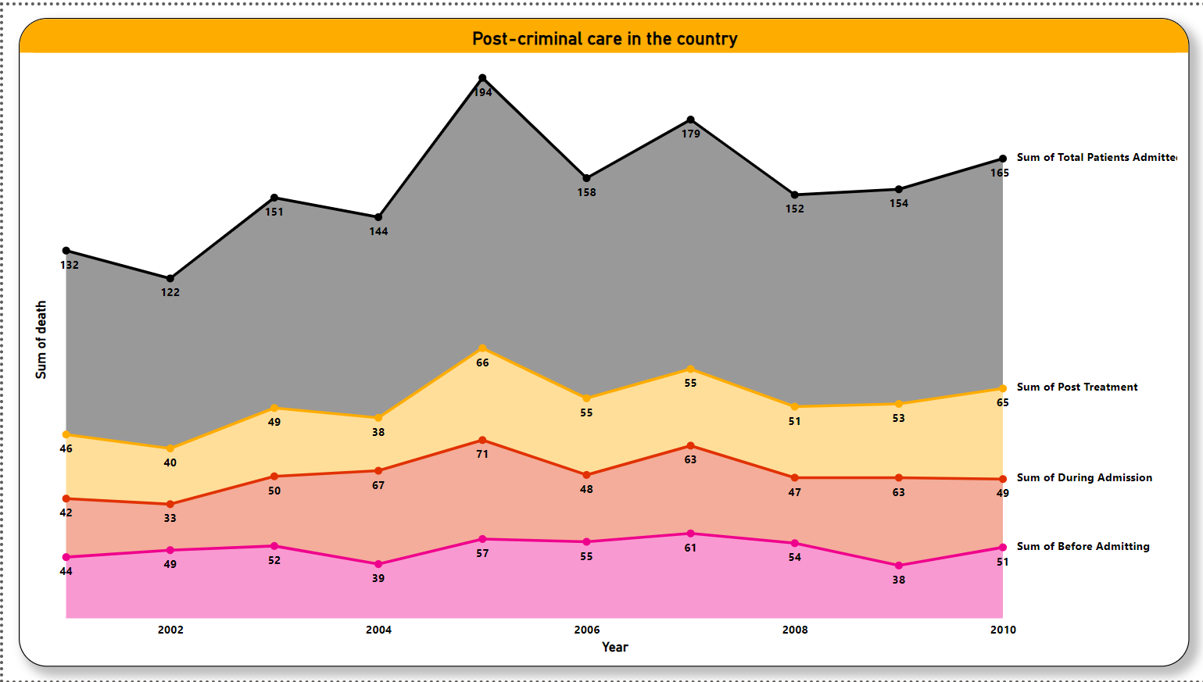
Healthcare system Analysis
The data illustrates a worrisome increase in annual admission rates.
Of particular concern is the post-treatment phase, where the number of admissions exerts a significant impact on the system.
Notably, the year 2005 recorded the highest admission count, while 2002 marked the lowest, underscoring the variability in critical outcomes over time.

Slide 25
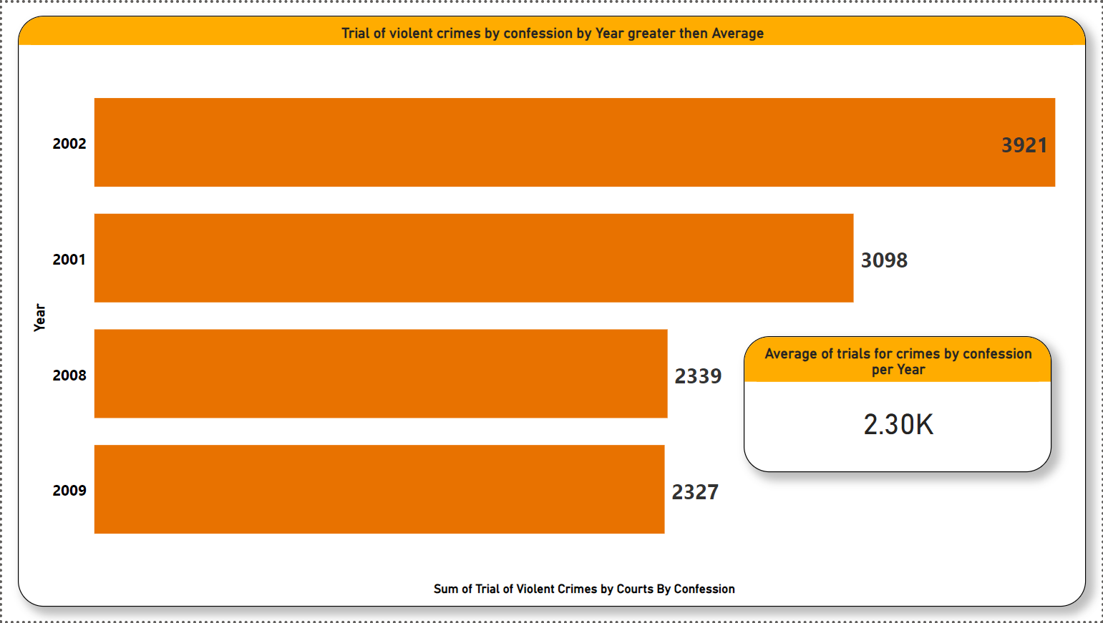
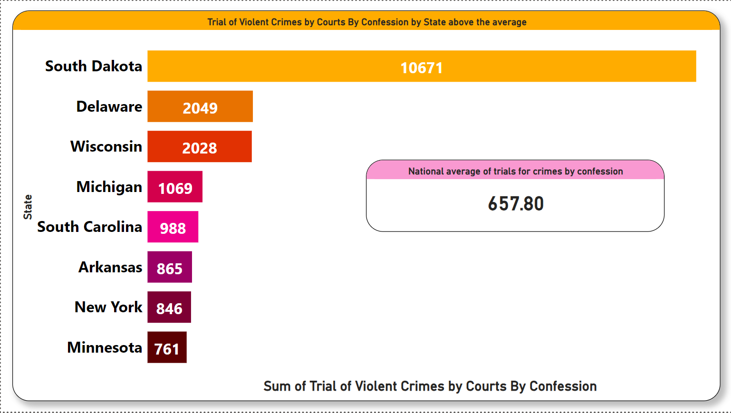
Number of trials for crimes by confession
The average for crime trials per year based on confessions is 2.30k. Notably, the year 2002 witnessed the highest number of trials.
The National average is 657.80.
The above chart depicts all the states having count greater then national average.

Slide 26
Insights after analysis
The males are committing crimes at regular rate per year.
The most striking is the count of youths and adults is increasing year by year.
The hotspots for all kind of crimes are Alaska, District of Columbia and Arkansas.
The most common crime activities are with an upward trend, are Drug Manufacturing and Distribution, Auto Theft, and Threatening-Intimidation.
The drug consumption is increasing year by year.
The youths are consuming a lot of drugs especially Cocaine and Cannabis.
The major hotspots are Alaska , New Mexico and Delaware for consumption.
Property crime is exhibiting a rapid and consistent increase, reaching new highs over the past 10 years.
The part of concern is the ratio of recovery is 0.43 which shows the inability to find stolen property.

Slide 27
Insights after analysis
Montana has highest of 0.61 ratio while Alaska has 0.71 by value.
Arkansas local police is poorly performing with highest property crime of 108.57bn stolen but only 14% recovered.
Suddenly, human rights violations by the police have seen a decreasing trend.
The count of charge-sheeted police officers significantly dropped, reaching its lowest in 2010 after a peak in 2007.
The data illustrates a worrisome increase in annual admission rates.
Of particular concern is the post-treatment phase, where the number of admissions exerts a significant impact on the system.
The number of trails for crime by confession has decreased year on year.

Slide 28
Steps to be taken
Focus on male especially youths in Alaska, District of Columbia and Arkansas.
Provide them good facilities so that they are distracted from crimes.
Create awareness of drug consumption effects.
The properties in Montana and Alaska can be insured as the efficiency of recovery is high. The suggestion would be Homeowners Insurance, Renters Insurance and Valuables Insurance
Increase security in Alaska and other hotspots.
Appreciation to the police for their efforts in reducing human rights violations.
The hospital management has been poor while post admission treatment . The suggestion would be increase the number of workers , doctors and paperless admission to reduce time for treatment.
The construction of more hospitals in major hotspots especially around educational structure would help as the youths are committing highest crime. "Implementing decisive measures and conducting consistent evaluations to proactively identify and address potential involvement of youths in criminal activities."

Slide 29
As a participant, my analysis journey has been a quest to unravel the intricate patterns of crime in different aspects. Each insight derived from the dataset is a testament to the power of data-driven understanding. In this competition, I've strived to contribute meaningfully to the discourse on safety and justice. Thank you for the opportunity to explore, learn, and make a difference.
Thank You
By:-
Team Name :- varunpatil64228
Members :- Varun S (Member 1)

